Slide 1

Web Development with .NET Lecture 8: jQuery 29 March 2010
MET CS 651
“Taming Javascript”
(code examples by V. Azarkhin, Netwise)

Slide 2
Intro
JavaScript is a weakly typed, classless, prototype based OO language, that can also be used outside the browser
Javascript ASP.NET AJAX extensions add more object-orientation to Javascript
But still…
We’ve seen what AJAX technologies can do
Manipulating server-side presentation is real easy with ASP.NET
Streamlining data exchange between server and client is real easy with ASP.NET AJAX
But manipulating the client DOM is still hard..
Unless you really believe in client-side templates

Slide 3
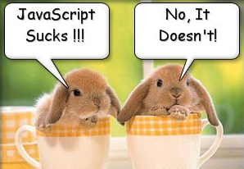
Which one are you?

Slide 4
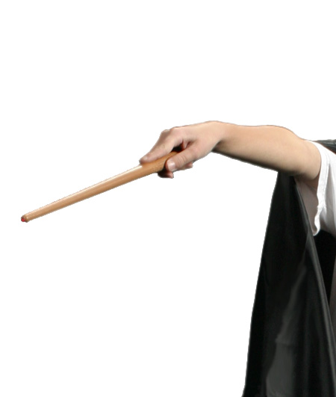
jQuery is..
jQuery is a powerful JavaScript Library that simplifies interaction between HTML and javascript
Used for document traversing, changing content and presentation, event handling, animation, and AJAX interactions
Produces more robust and more readable javascript
Cross browser : Latest version supports
IE 6.0+
FF2+
Safari 2.0+
Opera 9.0+
Supports CSS 1-3(Draft) and XPath
Lightweight (15 KB minified and Gzipped)
<html><head>
<script src="jquery.js" type="text/javascript alter the HTML "></script>
<script src="test.js" type="text/javascript"></script>
…

Slide 5
Guess what this does…
$(“#firstName”).text(“Joe Black”);
$(“button”).click(function() {alert “Clicked”;});
$(“.content”).hide();
$(“#main”).load(“content.htm”);
$(“<div/>”).html(“Loading…”).appendTo(“#content”);

Slide 6

It’s about quality of life!

Slide 7


Who wrote it?
It was and still being developed by John Resig from Mozilla
First announced in January 2006
Recently adopted by Microsoft
The current version is 1.3.2 (as of July 2009)
Download the latest version from http://jquery.com

Slide 8
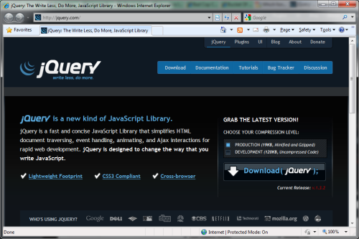
jQuery.com

Slide 9
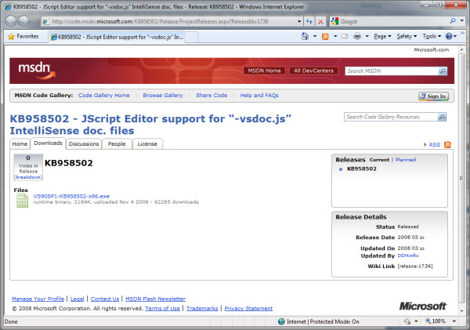
Intellisense in VS2008
To enable itellisense in VS 2008 SP1, install the -vsdoc hotfix: VS90SP1-KB958502-x86.exe

Slide 10
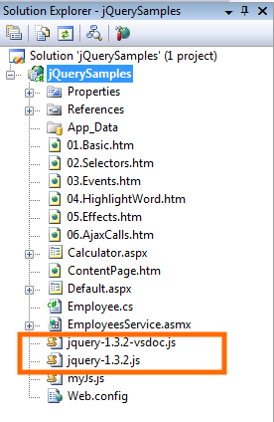
To Develop with jQuery
Copy the jquery.js and the jquery-vsdoc.js into your application folder
Reference it in your markup
No need to reference the –vsdoc.js
Or reference it from Google
<script src=“jquery.js”/>
<script src=“http://ajax.googleapis.com/ ajax/libs/jquery/1.2.6/ jquery.min.js”> </script>

Slide 11
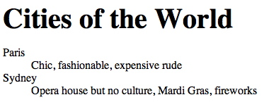
Learning by Hands-on… Class Demo #1
<html>
<body>
<h1>Cities of the World</h1>
<dl>
<dt>Paris</dt><dd>Chic, fashionable, expensive rude</dd>
<dt>Sydney</dt><dd>Opera house but no culture, Mardi Gras, fireworks</dd>
</dl>
</body>
</html>
h1 {font-size: 2.5em; margin-bottom: 0;}
.emphasize {font-style: italic; color:red;}

Slide 12
jQuery 101
A jQuery object is a wrapper for a selected group of DOM nodes
$() function is a factory method that creates jQuery objects
$(“dt”) is a JQuery object containing all the “dt” elements in the document
.addClass() method changes the DOM nodes by adding a ‘class’ attribute
The ‘class’ attribute is a special CSS construct that provides a visual architecture independent of the element structures
$(“dt”).addClass(“emphasize”) will change all occurrences of <dt> to <dt class=“emphasize”>

Slide 13
jQuery 101
To make this change, put it in a function and call it when the document has been loaded and the DOM is created:
function doEmph(){$(“dt”).addClass(“emphasize”)}
<body onLoad=“doEmph()”>
We had to alter the HTML (bad)
Structure and appearance should be separated!
Also, onLoad waits until all images etc are loaded. Tedious
JQuery provides an independent scheduling point after DOM is created and before images are loaded $(document).ready(doEmph);
No HTML mods required. All done in script!
So, better solution:
$(document).ready(function(){
$(“dt”).addClass(“emphasize”)
});
Does that remind you anything from our lambda/LINQ class?

Slide 14
$()
jQuery

Slide 15
$(): What is it?
The full name of $() function is
jQuery(“div”);
It may be used in case of conflict with other frameworks

Slide 16
$() Creating DOM elements
The Magic $() function
var el = $(“<div/>”)
Create HTML elements on the fly

Slide 17
$() Manipulating DOM elements
The Magic $() function
$(window).width()
Manipulate existing DOM elements

Slide 18
$() Selecting DOM elements
The Magic $() function
$(“div”).hide();
$(“div”, $(“p”)).hide();
Selects document elements
(more in a moment…)

Slide 19
$() Eventing DOM elements
The Magic $() function
$(function(){…});
Fired when the document is ready for programming. Better use the full syntax:
$(document).ready(function(){…});

Slide 20
jQuery Philosophy
GET >> ACT
$(“div”).hide()
$(“<span/>”).appendTo(“body”)
$(“:button”).click()

Slide 21
jQuery Chainability
$(“div”).show() .addClass(“main”) .html(“Hello jQuery”);
Almost every function returns jQuery, which provides a fluent programming interface and chainability

Slide 22
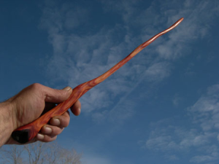

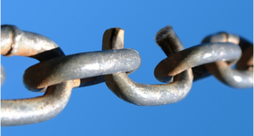
The 3 Basic Concepts behind jQuery
The $() function
Get > Act
Chainability

Slide 23
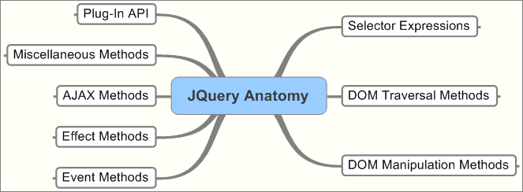
jQuery Capabilities

Slide 24
Avoiding $() Conflict with other Frameworks
var foo = jQuery.noConflict();
// now foo() is the jQuery main function
foo(“div”).hide();

Slide 25
Learning by example
jQuery

Slide 26
jQuery Basic Selectors
By Tag:
$(“div”)
// <div>Hello jQuery</div>
By ID:
$(“#usr”)
// <span id=“usr”>John</span>
By Class:
$(“.menu”)
// <ul class=“menu”>Home</ul>
Yes, jQuery implements CSS Selectors!

Slide 27
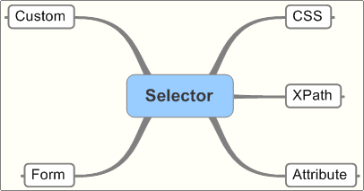
jQuery Selector

Slide 28
Comparing javascript to jQuery
document.getElementById("ID")
Returns DOM object with and id of ID
getElementsByTagName("TAG")
Returns an array of objects, all of type TAG
$(“#id”)
get element by ID
$(“tag”)
get element by tag
$(".classname")
get element by class

Slide 29
jQuery Refined Selectors
$(“div.main”) // tag and class
$(“table#data”) // tag and id

Slide 30
jQuery Selector Combo
// find by id + by class
$(“#content, .menu”)
// multiple combination
$(“h1, h2, h3, div.content”)

Slide 31
Equivalence (Currying)
// select paragraph and then find // elements with class ‘header’ inside $(“p”).find(“.header”).show(); // equivalent to: $(“.header”, $(“p”)).show();

Slide 32
jQuery Selector Index Filters
$(“tr:first”) // first element
$(“tr:last”) // last element
$(“tr:lt(2)”) // index less than
$(“tr:gt(2)”) // index gr. than
$(“tr:eq(2)”) // index equals

Slide 33
jQuery Selector Attribute Filters
$(“div[id]”) // has attribute
$(“div[dir=‘rtl’]”) // equals to
$(“div[id^=‘main’]”) // starts with
$(“div[id$=‘name’]”) // ends with
$(“a[href*=‘msdn’]”) // contains

Slide 34
jQuery Form Selectors
$(“input:checkbox”) // checkboxes
$(“input:radio”) // radio buttons
$(“:button”) // buttons
$(“:text”) // text inputs
$(“input:checked”) // checked
$(“input:selected”) // selected
$(“input:enabled”) // enabled
$(“input:disabled”) // disabled

Slide 35
RECAP #1
jQuery

Slide 36
jQuery Selectors
HTML/CSS
p element name
#id identifier
.class classname
$(".myClass“) select all element with myClass CSS class
p.class element with class
p a anchor as any descendant of p
p > a anchor direct child of p
Xpath
/html/body//div paths
a[@href] anchor with an href attr
div[ol] div with an ol inside
//a[@ref='nofollow'] any anchor with a specific value for the ref attribute

Slide 37
jQuery Filters
p:first first paragraph
li:last last list item
a:nth(3) fourth link
a:eq(3) fourth link
p:even or p:odd every other paragraph
a:gt(3) or a:lt(4) every link after the 4th or up to the fourth
a:contains(‘click’) links that contain the word click
Example
$(‘a:contains("ECS")’).parent().addClass("emphasize")

Slide 38
Learning by example
jQuery

Slide 39
The Wild Card
$(“*”) // find everything
Selectors return a pseudo-array of jQuery elements

Slide 40
Selector Success?
Best way to check if Selector returned array
$(“div”).length

Slide 41
DOM Selector
Returning the 3^{3d} DOM element of a tag
$(“div”).get(2) or $(“div”)[2]

Slide 42
Exploring the DOM
Find Dropdown Selected Item
<select name=“cities”>
<option value=“1”>Tel-Aviv</option>
<option value=“2” selected=“selected”>Paris</option>
<option value=“3”>Moscow</option>
</select>
$(“select[name=‘cities’] option:selected”).val()

Slide 43
Traversing the DOM
.next(expr) // next sibling
.prev(expr) // previous sibling
.siblings(expr) // siblings
.children(expr) // children
.parent(expr) // parent

Slide 44
Changing DOM Content
$(“p”).html(“<div>Hello $!</div>”);
// get the value of the checked checkbox $(“input:checkbox:checked”).val();
// set the value of the textbox $(“:text[name=‘txt’]”).val(“Hello”);
// select or check lists or checkboxes $(“#lst”).val([“NY”,”IL”,”NS”]);

Slide 45
Finding DOM elements
// select paragraph and then find // elements with class ‘header’ inside $(“p”).find(“.header”).show(); // equivalent to: $(“.header”, $(“p”)).show();

Slide 46
Inserting & Replacing DOM Elements
// select > append to the end $(“h1”).append(“<li>Hello $!</li>”);
// select > append to the beginning $(“ul”).prepend(“<li>Hello $!</li>”);
// create > append/prepend to selector $(“<li/>”).html(“9”).appendTo(“ul”);
$(“<li/>”).html(“1”).prependTo(“ul”);
// select > replace $(“h1”).replaceWith(“<div>Hello</div>”);
// create > replace selection $(“<div>Hello</div>”).replaceAll(“h1”);

Slide 47
Inserting elements & preserving content
$(“h3”).each(function(){ $(this).replaceWith(“<div>” + $(this).html() + ”</div>”); });

Slide 48
Deleting elements
// remove all children $(“#mainContent”).empty();
// remove selection $(“span.names”).remove();
// change position $(“p”).remove(“:not(.red)”) .appendTo(“#main”);

Slide 49
Handling Attributes
$(“a”).attr(“href”,”home.htm”); // <a href=“home.htm”>…</a>
$(“img”).attr({ “src” : “/images/smile.jpg”, “alt” : “Smile”, “width” : 10, “height” : 10 });

Slide 50
Traversing & Manipulating the DOM
Each(fn) traverses every selected element and applies fn to it
this is current DOM selection
var sum = 0; $(“div.number”).each( function(){ sum += (this.innerHTML); });

Slide 51
Traversing & Manipulating the DOM
each(fn) also passes an indexer
$(“table td”).each(function() { if ($(this).is(“:first-child”)) { $(this).addClass(“firstCol”); } });
$(this) – convert DOM to jQuery i - index of the current element

Slide 52
Manipulating the DOM with indexer
$(this) – convert DOM to jQuery i - index of the current element
$(“table tr”).each( function(i){ if (i % 2) $(this).addClass(“odd”); });

Slide 53
CSS
jQuery

Slide 54
Handling CSS classes
// add and remove class $(“p”).removeClass(“blue”).addClass(“red”);
// add if absent, remove otherwise $(“div”).toggleClass(“main”);
// test for class existance if ($(“div”).hasClass(“main”)) { //… }

Slide 55
CSS manipulations
// get style $(“div”).css(“background-color”);
// set style $(“div”).css(“float”, “left”);
// set multiple style properties $(“div”).css({“color”:”blue”, “padding”: “1em” “margin-right”: “0”, marginLeft: “10px”});

Slide 56
Event handling
jQuery

Slide 57
Attaching Events
// execute always $(“div”).bind(“click”, fn);
// execute only once $(“div”).one(“click”, fn);
blur, focus, load, resize, scroll, unload, beforeunload, click, dblclick, mousedown, mouseup, mousemove, mouseover, mouseout, mouseenter, mouseleave, change, select, submit, keydown, keypress, keyup, error

Slide 58
Detaching events
$(“div”).unbind(“click”, fn);

Slide 59
Events Triggering
Triggers browser’s event action as well.
Can trigger custom events.
Triggered events bubble up.
$(“div”).trigger(“click”);

Slide 60
Event helpers
// attach / trigger
elem.blur(fn) / elem.blur()
elem.focus(fn) / elem.focus()
elem.click(fn) / elem.click()
elem.change(fn) / elem.change()

Slide 61
Preventing browser default action
// use different triggering function $(“div”).triggerHandler(“click”);
// prevent default action in handler function clickHandler(e) { e.preventDefault(); }
// or just return false function clickHandler(e) {return false;}

Slide 62
Preventing bubbling
// stop bubbling, keep other handler function clickHandler(e) { e.stopPropagation(); }
// stop bubbling and other handlers function clickHandler(e) { e.stopImmediatePropagation(); }
// or just return false function clickHandler(e) {return false;}

Slide 63
effects
jQuery

Slide 64
Showing/Hiding
// just show $(“div”).show();
// reveal slowly, slow=600ms $(“div”).show(“slow”);
// hide fast, fast=200ms $(“div”).hide(“fast”);
// hide or show in 100ms
$(“div”).toggle(100);
$(“div”).fadeIn(“fast”);
$(“div”).fadeOut(“normal”);
// fade to a custom opacity $(“div”).fadeTo (“fast”, 0.5);

Slide 65
Detecting Animation Completion
$(“div”).hide(“slow”, function() { alert(“The DIV is hidden”); });
$(“div”).show(“fast”, function() { $(this).html(“Hello jQuery”); }); // this is a current DOM element

Slide 66
Custom Animations
// .animate(options, duration) $(“div”).animate({ width: “90%”, opacity: 0.5, borderWidth: “5px”
}, 1000);
$(“div”).animate({width: “90%”},100) .animate({opacity: 0.5},200) .animate({borderWidth: “5px”});

Slide 67
Loading content
jQuery + AJAX

Slide 68
Loading Content
$(“div”).load(“content.htm”);
// passing parameters $(“#content”).load(“getcontent.aspx”, {“id”:”33”, “type”:”main”});

Slide 69
Sending GET/POST Requests
$.get(“test.aspx”, {id:1}, function(data){alert(data);});
$.post(“test.aspx”, {id:1}, function(data){alert(data);});

Slide 70
Retrieving JSON Data
$.getJSON(“users.aspx”, {id:1}, function(users) { alert(users[0].name); });

Slide 71
Retrieving JS files
$.getScript(“script.js”, function() { doSomeFunction(); });

Slide 72
extensibility
jQuery

Slide 73
Adding Methods
// definition jQuery.fn.printLine = function(s) { return jQuery(this).each(function() { this.append(“<div>”+ s +“</div>”); }); };
// usage $(“#log”).printLine(“Hello”);

Slide 74
review
jQuery

Slide 75
Aggregation
:first
:last
:even
:odd
$("div p") gets all the <p> tags within any <div> tags
$("div:first") gets all first children elements of any <div> tags

Slide 76
jQuery Events, Effects, and DOM mods
bind(eventname, function) method
Example
$(“a[@href]”).bind(‘click’,function(){$(this).addClass(‘red’);});
$(‘<i>hello</i>’)
Creates a new element
$(‘<i>hello</i>’).insertAfter(‘div.chapter p’);

Slide 77
jQuery Events, Effects, and DOM mods
object.html()
Returns object’s innerHTML
object.html(‘some html’)
Sets object’s html
$(".alert").html(“I’m of class alert”);
Sets the html of all elements with a class of ‘alert’ to “I’m of class alert”
$(".alert").css(‘background-color’, ‘red’);
Sets the background color of all elements belonging to the alert class to red
$(#identifier).action()
Perform action() on element with id identifier
.each(function())
Perform function() on all matched elements

Slide 78
jQuery Events, Effects, and DOM mods
.append( content )‏;
Append content inside elements
.prepend( content );‏
Prepend content inside elements
.after( content );‏
Place content after elements
.before( content )‏;
Place content before elements

Slide 79
jQuery Events, Effects, and DOM mods
$(document).ready( function() );
Set function to execute when the DOM is loaded
$(“#fstName”).change( function() );
Set function to execute when the fstName field is changed
$(“#myLink”).click( function() );
Set function to execute when #myLink is clicked
$(“#email”).focus( function() );
Set function to execute when email field has focus

Slide 80
jQuery Events, Effects, and DOM mods
.show();
Show the matched element(s)‏
.hide();
Hide the matched element(s)‏
.slideDown();
Slide-show the matched element(s)‏
.fadeIn();
Fade in the matched element(s)‏

Slide 81
A Word about Performance
Every $/Find searches using attribute /element parses the DOM for elements
Excessive use can cause the browse to hang.
Use ID selector as much as possible
$(“input”) will perform slower than
$(“#tableName input”) which will be faster

Slide 82
jQuery class Demo #2
AJAX + jQuery = Kowabungaaaaaaaaaa!

Slide 83
jQuery URLs
www.jquery.com – jQuery homepage
www.learningjquery.com – jQuery tutorial blog
www.visualjquery.com – jQuery documentation
http://ui.jquery.com – jQuery user interface
http://bassistance.de/jquery-plugins/ - homepage of the author of several useful jQuery plugins
http://docs.jquery.com/How_jQuery_Works
http://docs.jquery.com/Tutorials

Slide 84
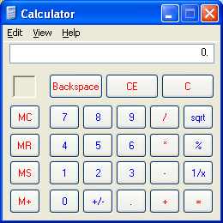
Homework
Implement a server-side Calculator with scripted Web Service, AJAX, and jQuery: it responds to client-side events to pick two numbers and an operation, computes the result on the server side, and returns it to the client

Slide 85


Next week: Homework and exam grades, and Class Project Presentations
And special topic:
Comp Sci. or
Hands-on

Slide 86


